Slide 1
What is Computer Network
A computer network is a set of computers connected together for the purpose of sharing resources
A computer network is a group of computer systems and other computing hardware devices that are linked together through communication channels to facilitate communication and resource-sharing among a wide range of users

Slide 2
What is Internet
A global computer network providing a variety of information and communication facilities, consisting of interconnected networks using standardized communication protocols.

Slide 3
Advantages of Network
Speed
Cost
Security
Centralized Software Management
Resource Sharing
Electronic Mail
Flexible Access
Workgroup Computing

Slide 4
Disadvantage of Network
Server fault stop application being available
Network faults can cause loss of data
Network fault could lead to loss of resource
User work dependent upon network
System open to hackers
Decisions trend to become centralized
Could become inefficient
Could degrade in performance
Resources could be located too far from users
Network management can become difficult

Slide 5
Types of Networks
LAN - Local Area Network
WLAN - Wireless Local Area Network
WAN - Wide Area Network
MAN - Metropolitan Area Network
SAN - Storage Area Network, System Area Network, Server Area Network, or sometimes Small Area Network
CAN - Campus Area Network, Controller Area Network, or sometimes Cluster Area Network
PAN - Personal Area Network
DAN - Desk Area Network

Slide 6
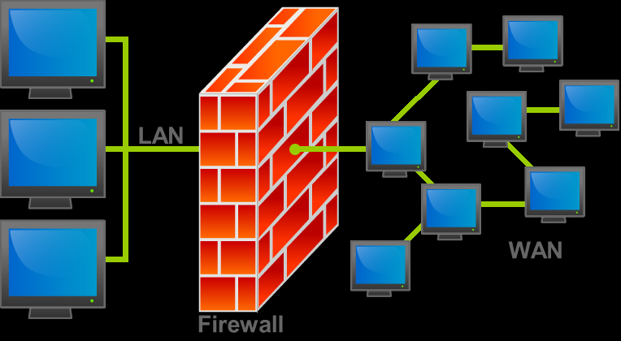

Slide 7
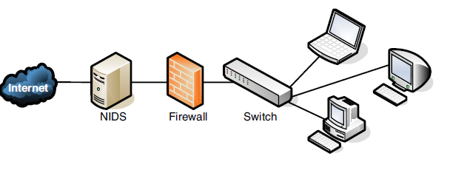

Slide 8
Data Communications
Local communication face-to-face
Remote communication is telecommunication
Tele is Greek word “Far”
The data refers to information present in whatever form is agreed upon by two parties creating and using the data
Data Communication are the exchange of data between two devices via some form of transmission medium such as cable wire

Slide 9
Data Communications
Fundamental Characteristics
  Delivery
  Accuracy
  Timeliness
  Jitter

Slide 10
Data Communications
Data communication systems has five components
  Message
    Text
    Pictures
    Audio & video
  Sender
    Computer
    Workstation
    Telephone handset
    Video camera
  Receiver
  Transmission Medium
    Twisted -pair wire
    Coaxial cable
    Fiber-optic cable
    Radio waves
  Protocol

Slide 11
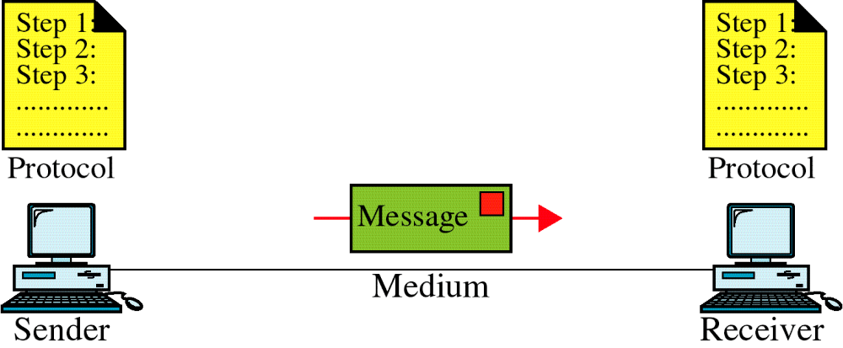
Data Communication System Components

Slide 12
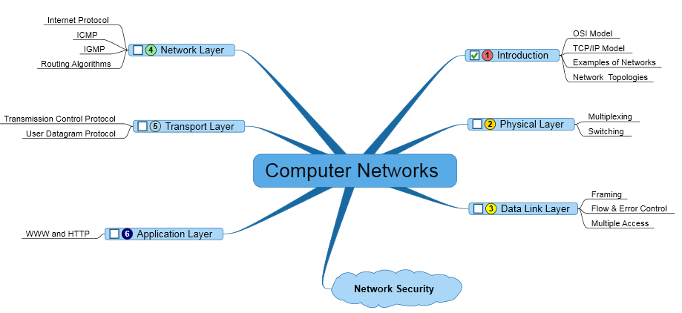
Data Communication and Networks

